Slide 1

Legislation Regarding
Therapeutic Diet Order Privileges
Task Force Chair, Josephine Connolly-Schoonen, PhD, RD

Slide 2

Objective
Protect the public through delivery of the most appropriate diet/nutrition therapy while in a hospital or long-term care facility
Increase efficiency of operations related to food and nutrition in hospitals and long-term care facilities
CMS estimates that having RDs write diet orders would save $459 million annually
Achieve objectives through passage of bills to amend NYS Department of Education Law establishing certification of nutritionists/dietitians (Education Law Article 157)
Senate bill S.3330
Assembly bill A.6398
“same as bills”
Covers CDNs and RDN/CDNs in NYS

Slide 3
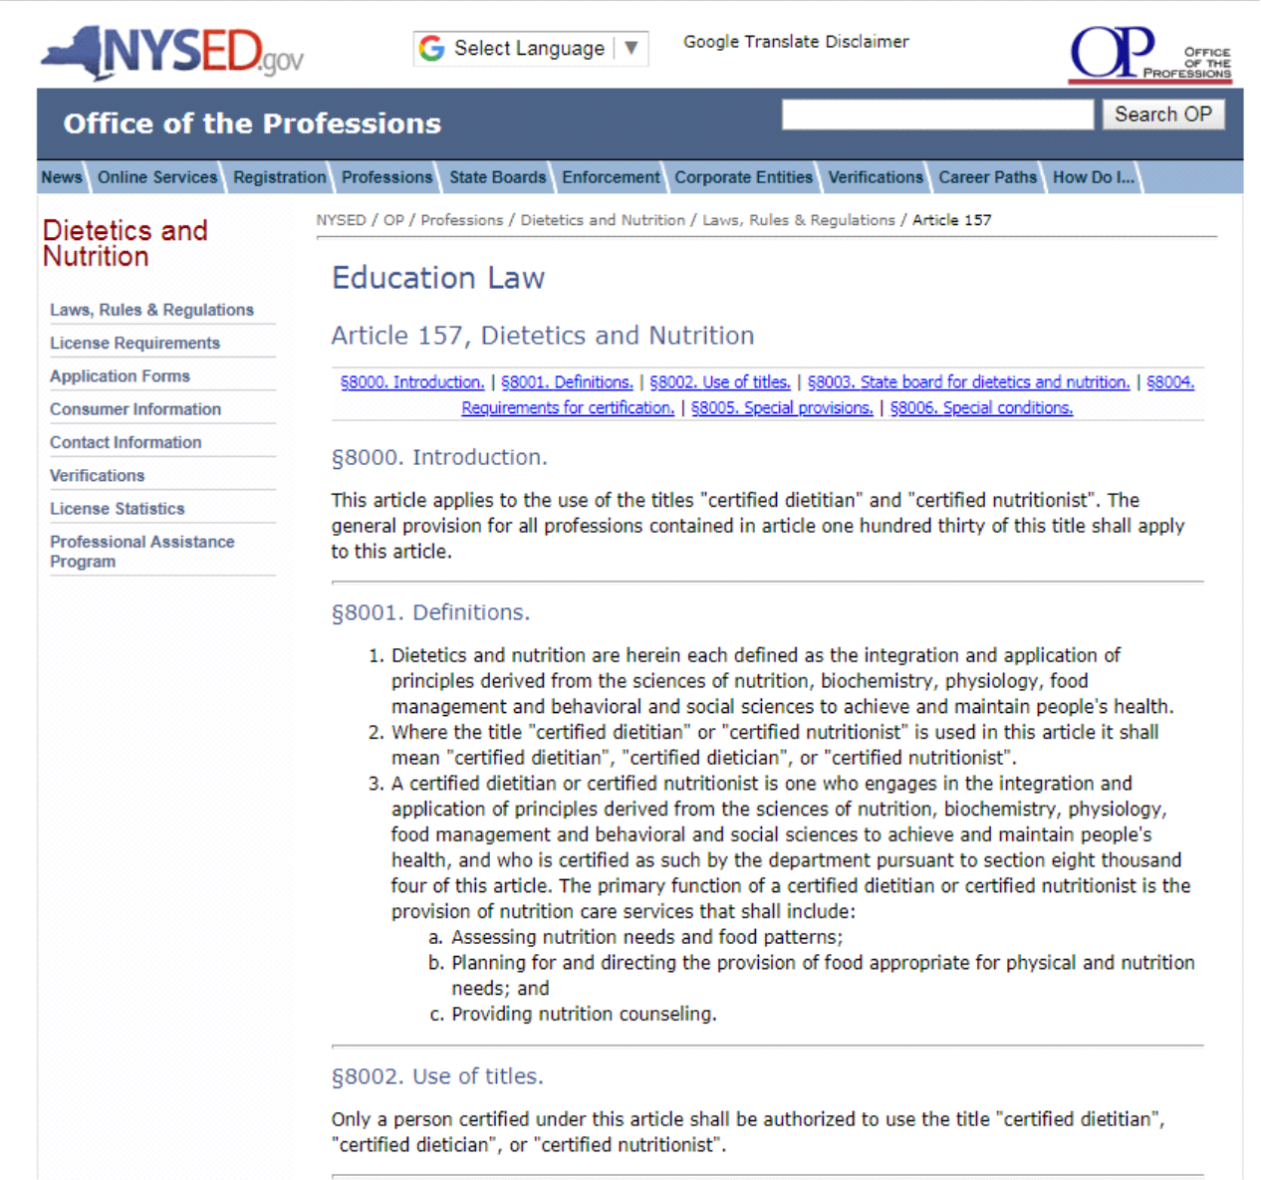

Slide 4
What’s in the amendment?
Language of Amendment:
“Notwithstanding any other provision of law to the contrary, a certified dietitian or certified nutritionist may prescribe, order, write, review, evaluate, monitor and manage therapeutic diets, including enteral and parenteral nutrition, in hospitals, including diagnostic center, treatment center, or hospital-based outpatient department, residential health care facility or nursing home of any other facility as defined in section twenty-eight hundred one of the public health law when competency is determined by the medical director or governing body of such facility.”
“order” term necessary for RNs to be able to administer such TF or TPN
“prescribe” term necessary for pharmacists to dispense such TPN
It is PERMISSIVE and INCLUSIVE
Allows hospitals and long term care facilities to go through the process of getting privileges for RD/CDNs to write diet orders to the extent desired; does not mandate such facilities to do so
Includes RD/CDNs as one of many health care providers that can write diet orders, including attending physicians, resident physicians, NPs, PAs

Slide 5
Why is this important?
Improves patient safety and clinical care
Increase efficiency and productivity of RD/CDNs in hospitals and long term care facilities; as well as all members of the health care teams
Currently RD/CDNs can propose diet orders; it currently takes about 1-4 hours to reach MD and have proposed diet order signed. (e.g. carbohydrate modifications to po diet orders, texture modifications and tube feeding orders /modifications)
RD/CDNs repeatedly identify wrong diet consistency orders/trays and prevent their delivery to patients Every day RD/CDNs propose carb modifiers that are missing from standing diet orders, but they need MD to sign “proposed diet orders” in EMR

Slide 6
Why Now?
The impetus of this activity is a ruling by the Centers for Medicare/Medicaid in May 2014 indicating that RDs are the professionals who are best qualified to provide medical nutrition therapy, including writing diet orders, and permitting hospitals/long-term care facilities to extend therapeutic diet order writing privileges to RDs.
Since RDs not “licensed” in NY, CMS ruling does not apply, unless we amend NYS Education law covering our certification
The COVID pandemic highlighted the need for TDO for patient safety and hospital operational efficiency
Every vented patient needed to be tube fed; many MDs reassigned to hospital units did not have experience writing diet orders
RDs most informed about shortages that impacted tube feeding orders
Tube feeding formulas
Equipement: pumps, bags, spike sets, etc.
Notes:
Tax Exempt

Slide 7
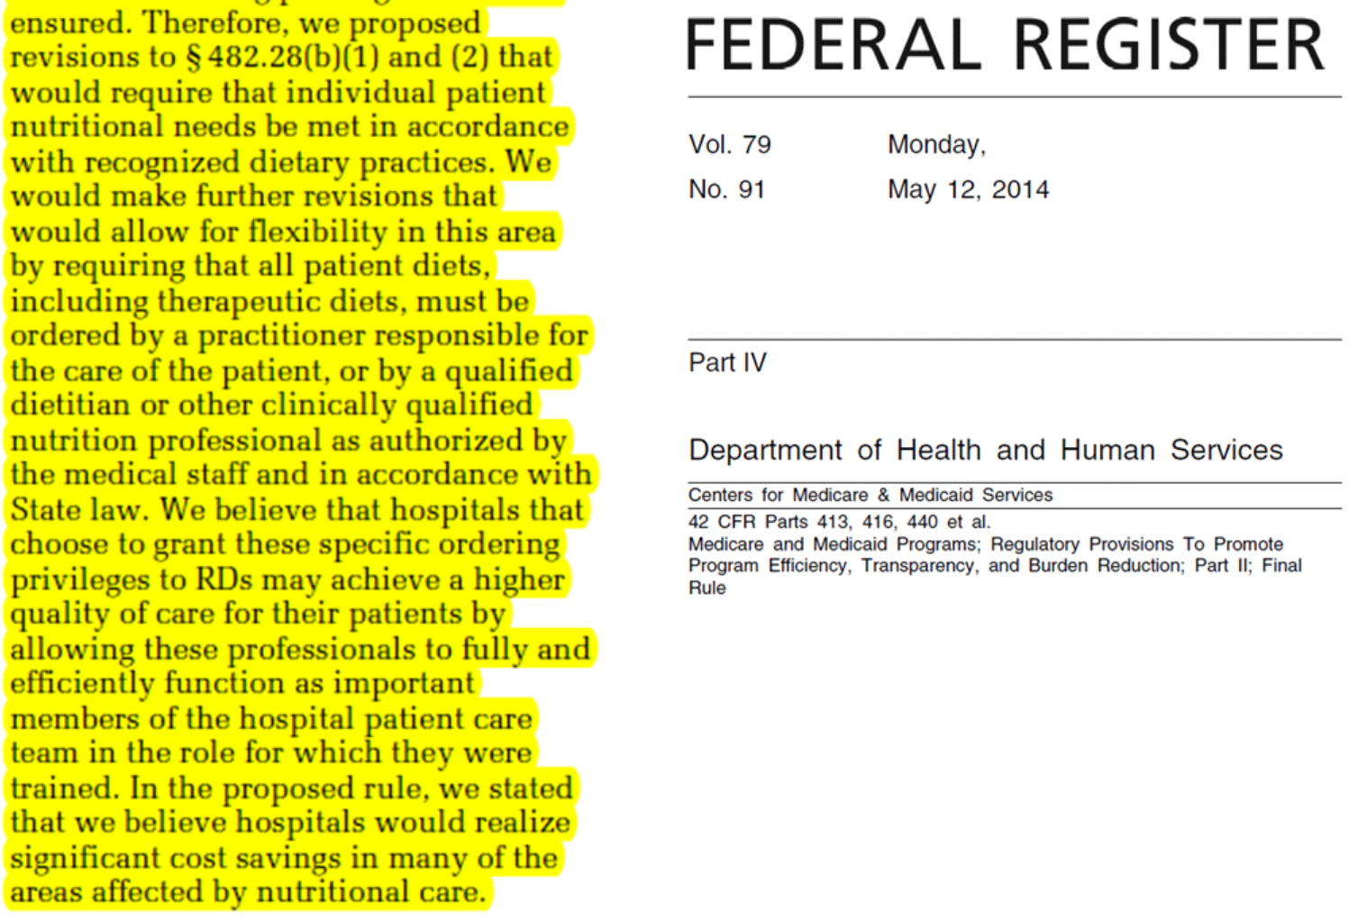

Slide 8
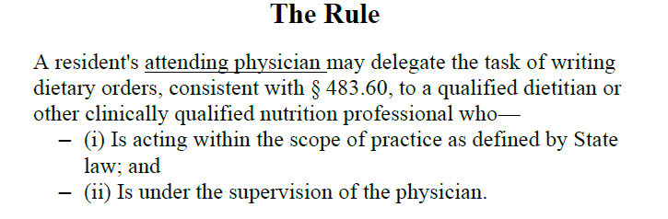
LTC Regulations
F715 Physician delegation to Dietitian
F808 Therapeutic Diet Prescribed by Physician
Notes:
Intent of the regulation is to provide physicians with the flexibility to delegate to a qualified dietitian / other clinically qualified nutrition professional the task of writing dietary orders. This flexibility is beneficial to the physician and the resident, allowing the physician to determine how to best use his or her time and allowing the resident to have more frequent adjustments to nutritional needs. Dietary orders written by a qualified dietitian / clinically qualified nutritional professional do not require physician co-signature except as required by State Law.
Probes for survey compliance – Did the attending physician delegate this task? Does the state law allow for delegation of the task? Is the dietitian functioning within the scope of practice defined by State Law? Is there evidence of supervision of the qualified dietitian by the physician?

Slide 9
What can each RD do?
Make sure you are a Certified Dietitian/Nutritionist: http://www.op.nysed.gov/prof/diet/dietforms.htm
Contact your own NYS Senator or Assembly Member requesting they co-sponsor these bills; ask your MD/RN colleagues to do the same
Determine your legislators:
https://nyassembly.gov/mem/search/
https://www.nysenate.gov/registration/nojs/form/start/find-my-senator
Determine if legislators already sponsored (see next 2 slides on how to determine this)
Call or email asking for co-sponsorship or thanking legislator
Better yet – visit!!! (may be via Zoom)
It is important to follow-up; check if they co-sponsored; if not ask if you can meet to further discuss
Contact sponsor of bills (template letter prepared); ask your MD/RN colleagues to do the same
Assembly Member Fred Thiele
New York State Assembly
Legislative Office Building, Room 837
Albany, NY 12248
Senator Gustavo Rivera (518-455-3395; grivera@nysenate.gov)
Chair, Committee on Health
New York State Senate
Capital Building, Room # 502C
Albany, NY 12247
Through networking with colleagues, advocate for support from fellow RDs, NYS physician/nursing professional associations; ask MDs/RNs to contact sponsors and/or their legislators

Slide 10
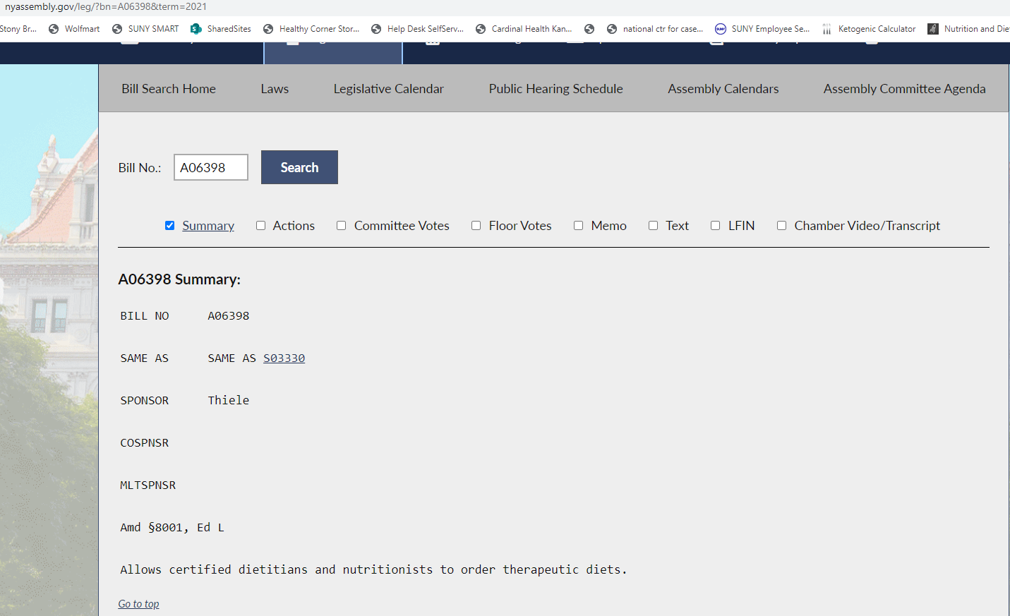
https://nyassembly.gov/leg/

Slide 11
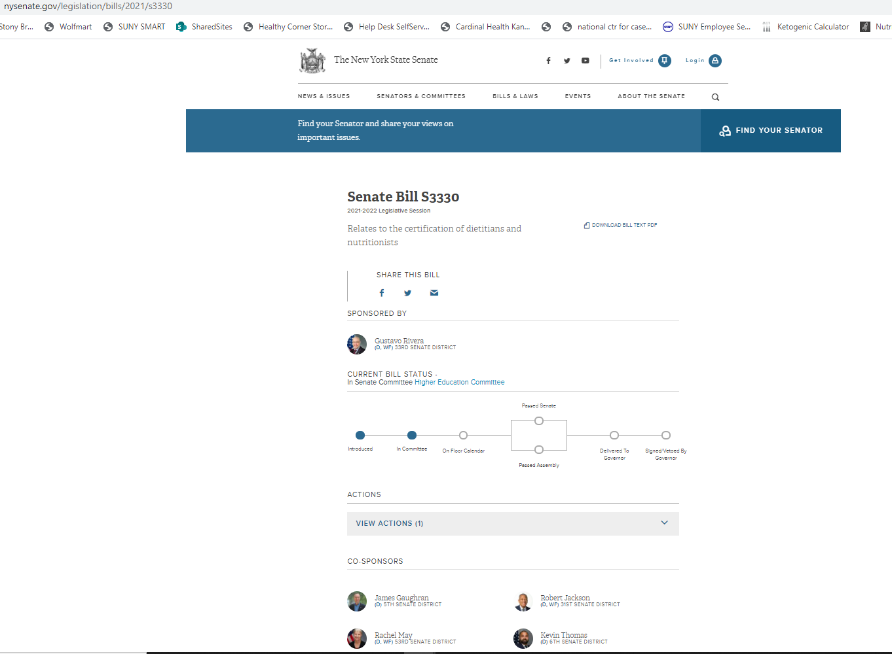
https://www.nysenate.gov/search/legislation fill in “Print No” - S3330

Slide 12
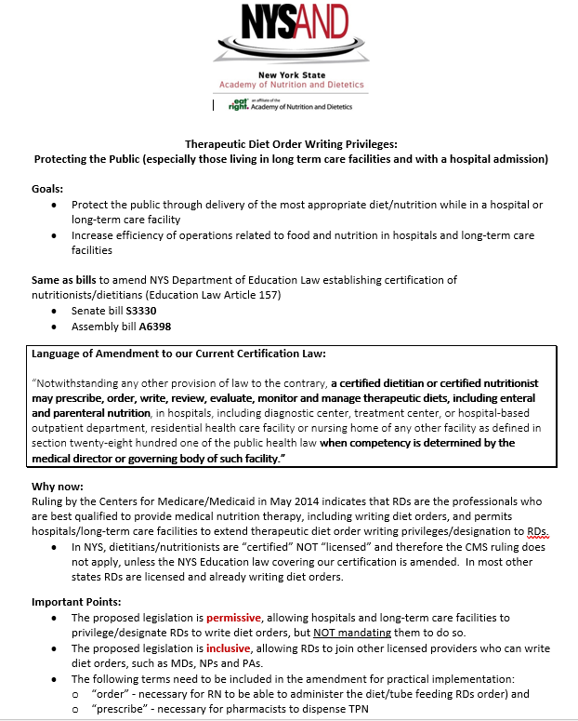
Summary document you can use to structure & guide your to your legislator!

Slide 13
Important Websites
NYSAND and LIAND
Tools for visits with elected officials
Sample email
Sample script for visit
TDO summary for legislators (also appropriate for your administrators) to you as guide or outline for your visit
FAQ (Frequently Asked Questions)

