Slide 1
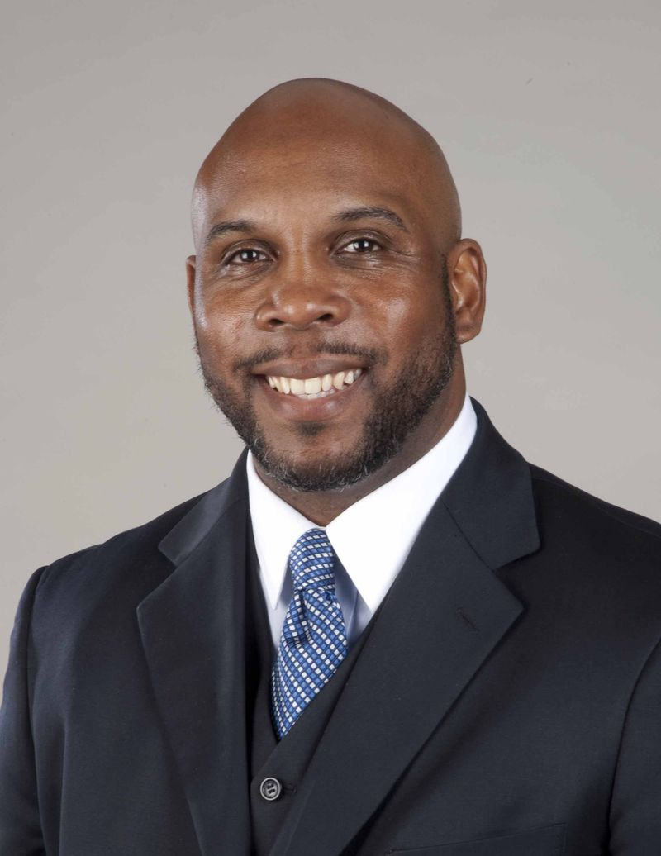
Monday, November 9
12:00 pm, Godwin-Ternbach Museum, Queens College
Omar Eaton-Martínez
Manager of Interns and Fellows, will discuss wonderful internship opportunities for Queens College students available at the Smithsonian.
Sponsored by: The Department of History
Co-Sponsors: Division of Social Sciences, Africana Studies, Center for Byzantine & Modern Greek Studies, Godwin-Ternbach Museum, Graduate School of Library and Information Science, and Latino Studies
Refreshments will be served

