Slide 1



Queens College & Ben-Gurion University of the Negev
Semester Abroad Fellowship
For people who care

Slide 2
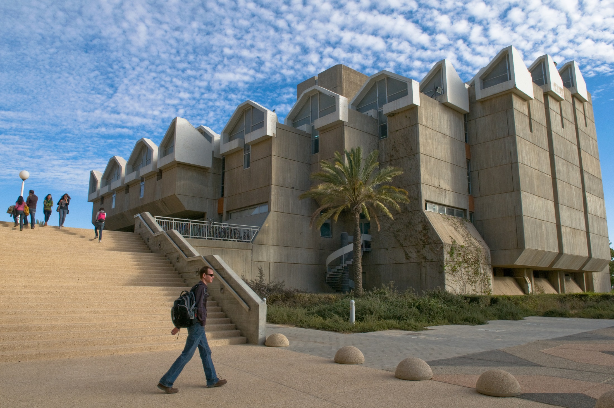
Ben-Gurion University of the Negev (BGU)
#30 in QS World University Rankings, Top 50 Under 50 (2014)
#24 in UI GreenMetric World University Ranking (2014)
Consistently voted #1 university for student experience by Israeli undergrads
Diverse student population of roughly 20,000
New Advanced Technology Park adjacent to campus

Slide 3
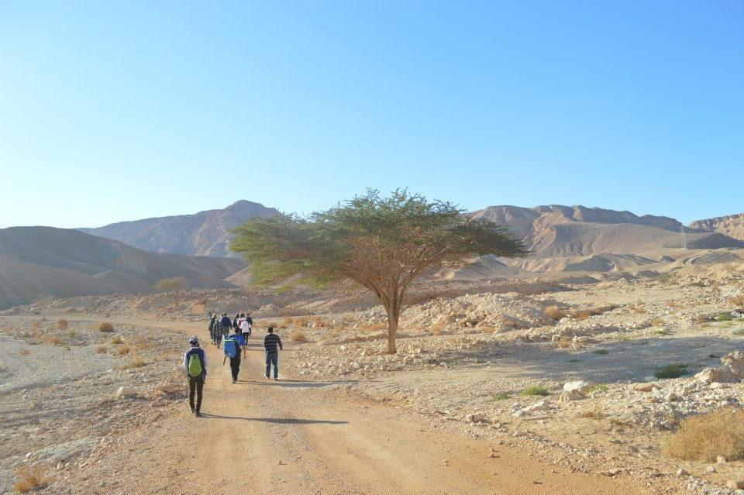
Beer-Sheva & the Negev
Israel’s 4th largest city and one of the oldest in the world
Israel’s Silicon Valley and cyber security capital
Named one of the world’s seven “cities of tomorrow” (Global Technology Emerging Markets)
The Negev Desert was recently named the #2 tourist destination in the world by Lonely Planet
Conveniently located to see the rest of Israel, with an on-campus train to Tel Aviv (45-60 minute trip)

Slide 4
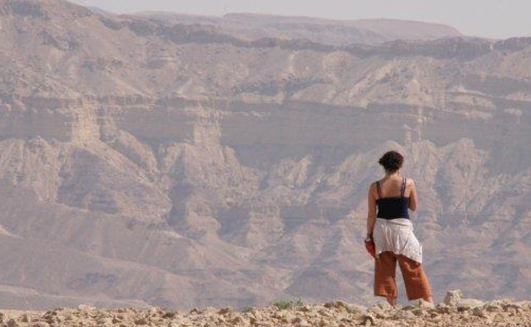
Semester Abroad Fellowship
Awarded to one outstanding QC student for Fall or Spring 2016 semester
Grant of $5,000 applied to tuition and other expenses, covering roughly 1/3 of the total program cost
Notes:
Covers approx. half of overall program costs

Slide 5

Overseas Student Program (OSP)
Take four courses taught in English per semester
Learn Hebrew language in an intensive ulpan
Enroll in a specialized track:
Entrepreneurship & Innovation (Spring)
Global Health (Spring)
Israel Studies (Fall)
Sustainable Development & Environment (Fall)
Participate in volunteer service or a research internship

Slide 6
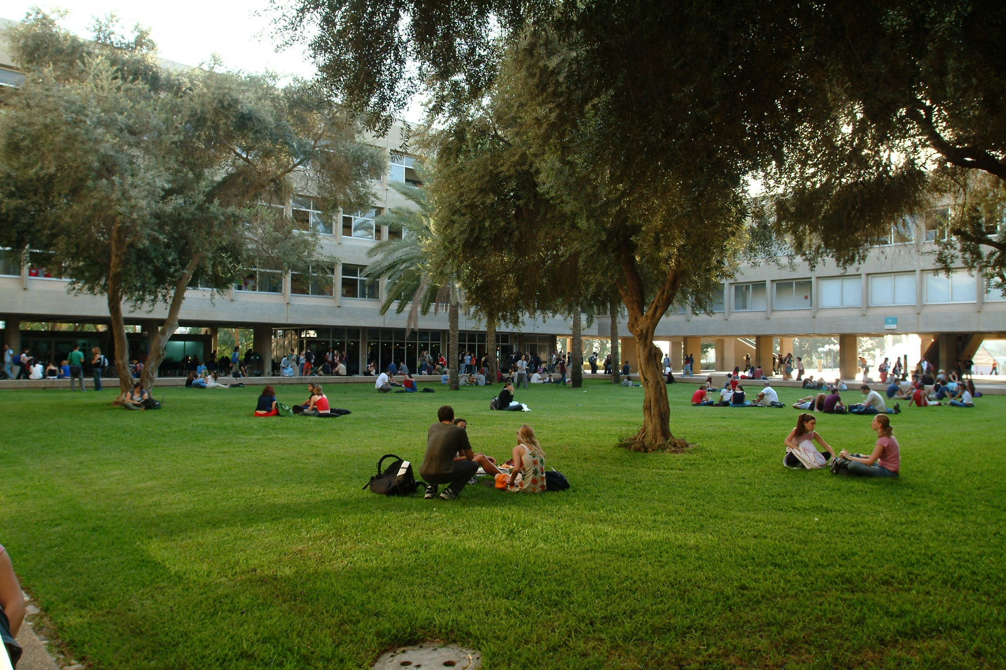
Diverse Study Options
Anthropology
Business
Environmental Sciences/Studies
Health Sciences
Hebrew
History
Middle Eastern Studies
Religious Studies
Sociology
*Students who speak Hebrew may enroll in BGU classes offered in Hebrew

Slide 7

Entrepreneurship & Innovation Track
Learn to develop and turn innovative business ideas into viable business ventures
Study in Israel, the “Start-up Nation” and leading country in high-tech and start-ups per capita
Engage with professionals ranging from young entrepreneurs to international industry leaders through BGU’s Innovation Un-Conference, the leading innovation event in Israel

Slide 8
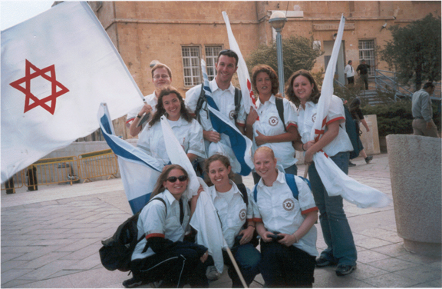
Global Health Track
Get an inside look into the emerging interdisciplinary field of global health
Study in Israel, a country at the forefront of bioscience and medical technologies
Take guided tours to medical facilities that practice or demonstrate aspects of global health, such as:
a clinic in a Bedouin town
a large Israeli hospital
an STD prevention program
an open clinic for migrant workers and refugees in Tel Aviv

Slide 9
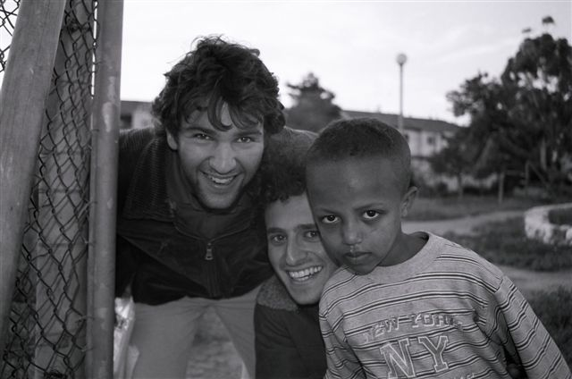
Israel Studies Track
Explore Israel of the past and present: work in world-renowned archives and engage in present-day field research
Study in the Negev region, where you’ll find the history, culture, and traditions of the diverse groups that make up Israeli society
Learn firsthand about the social forces that shape Israeli society

Slide 10
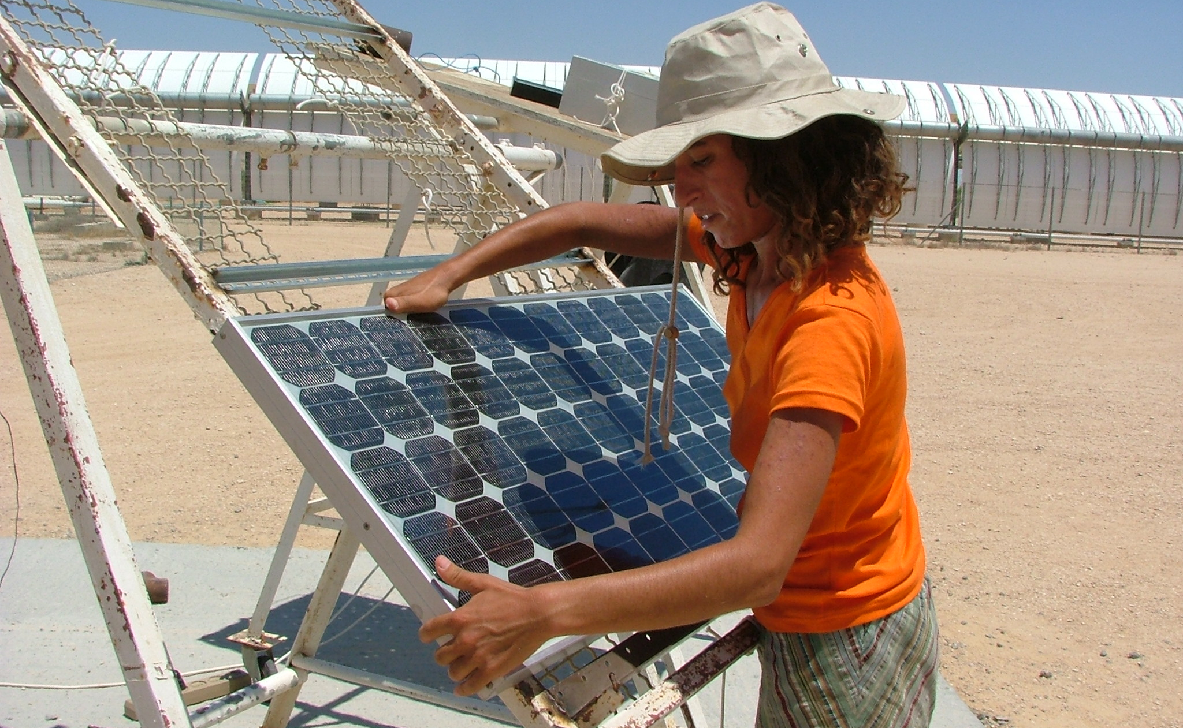
Sustainable Development & Environment Track
BGU is a leader in research on the challenges of sustainable development in the Middle East
Explore practical methods of sustainability and environmental management through field study and research
Analyze the factors promoting or hindering sustainable development in the Middle East and elsewhere

Slide 11

Academic Research Internships
Research internships for credit
Work in laboratories
Engagement with social service agencies that work with Ethiopian or Bedouin populations
Some of the previous placements:
Intern as one of your semester courses (for-credit)
Research with faculty members
Gain real-world work experience in your field of interest

Slide 12
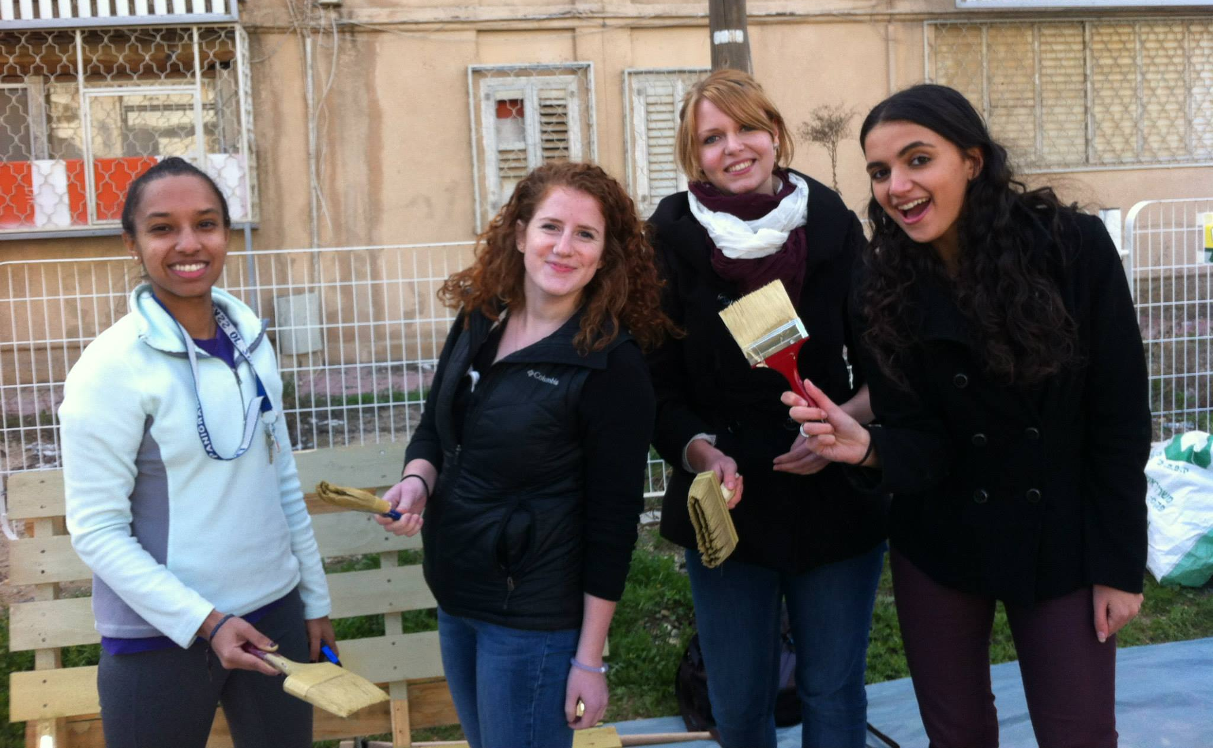
Volunteering
Students have volunteered in:
Beer-Sheva municipal offices
Soroka University Medical Center
Local art institutes
Newspapers and media organizations
Ben-Gurion University research institutes and centers
Local organizations working with children, at-risk youth, Bedouin communities, family centers, and high schools

Slide 13
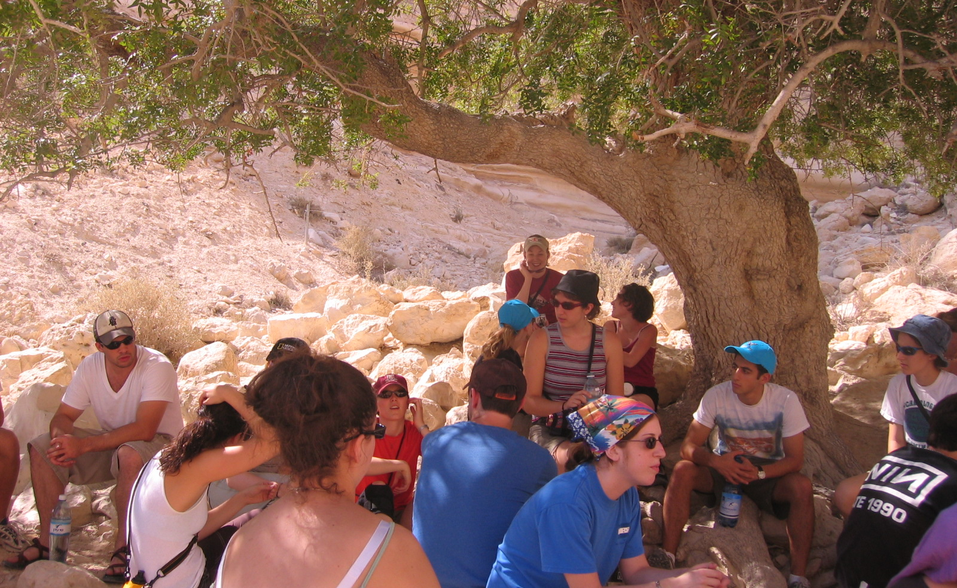
OSP Trips & Activities
Northern Israel – hiking/swimming in the Kinneret (Sea of Galilee)
Fura Reserve – to see annual wildflowers in bloom
Ilan Ramon Center – BGU’s planetarium
Beit Guvrin – ropes, rock, and cave climbing
Tel Sheva – archeological site and desert farms
Nahal Havarim – moonlight hike
Past trips have included:
Machtesh Gadol and Machtesh Katan (craters) – hiking

Slide 14
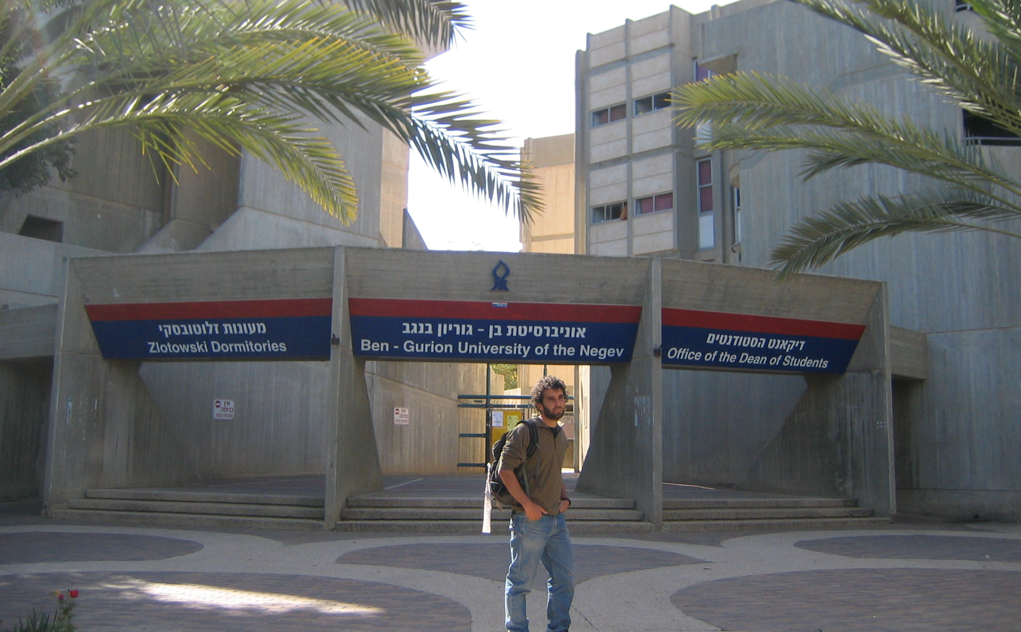
Housing
Live in BGU dormitories with Israeli students!
Furnished single bedrooms in three- or four-person apartments
Two-minute walk from campus
Dormitory complex features: mini-market, laundry facilities, 24-hour computer labs, music room, student lounges

Slide 15
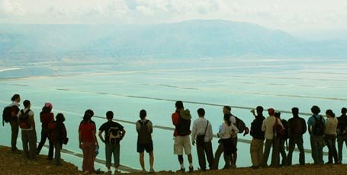
Fellowship Criteria
To apply:
Minimum GPA of 3.5
Two letters of recommendation
A 2-3 page essay on why you’d like to study at BGU
During and after the fellowship:
Keep a blog of your experience
Write a formal thank-you letter to donors upon return
Serve as ambassador of the program upon returning to campus
Notes:
Serve as ambassador through presentations and recruitment events, as requested by QC Office of Global Education Initiatives

Slide 16
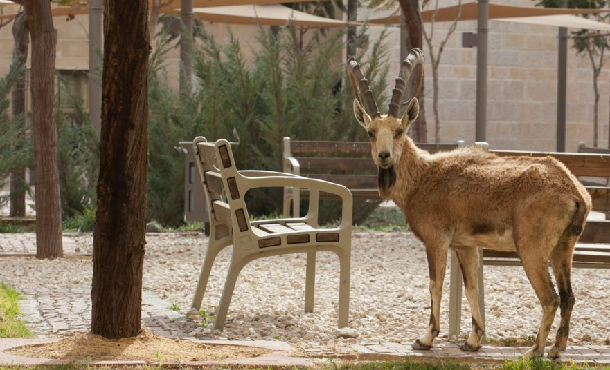
Application Deadlines
Fall semester:
April 15
Spring semester:
October 15

Slide 17
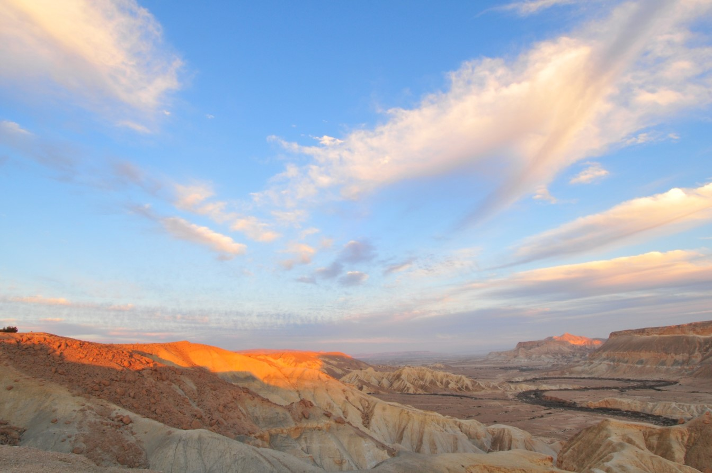
Application & More Information
To apply, please email:
Dr. Helen Gaudette
Office of Global Education Initiatives
Helen.Gaudette@qc.cuny.edu

Slide 18
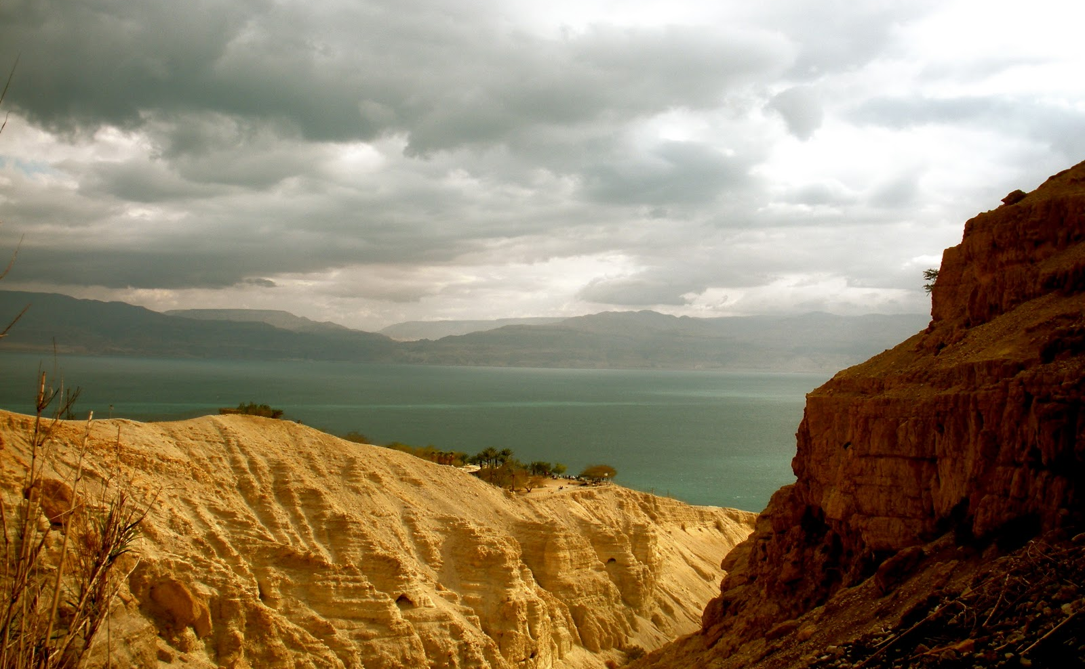
More about BGU & the OSP
Website: www.bgustudyabroad.org Facebook: http://www.facebook.com/BGU.OSP Twitter: http://twitter.com/bgu_osp Instagram: http://instagram.com/bgu_osp/
American Associates, Ben-Gurion University of the Negev New York Office Phone: 1-800-632-2248 Email: osp@bgustudyabroad.org

