Slide 1
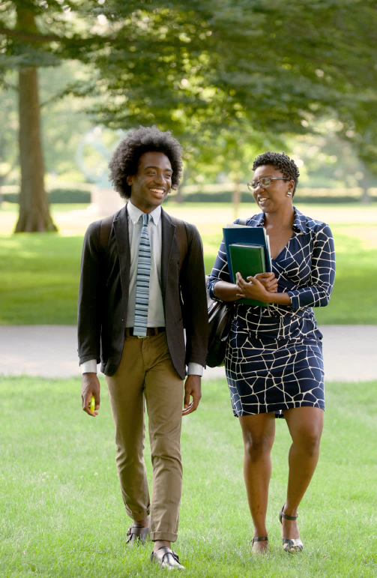

Interested in pursuing your Master’s or Ph.D?
Learn about how the IRT can help you with the graduate school application process!
Students interested in graduate studies in the Arts, Humanities, Social Sciences, Mathematics, Computer Science and Education are encouraged to attend!
INFORMATION SESSION:
Date: Friday, 12/7/18
Time: 3:00 – 4:00pm
Location: Powdermaker Hall Room 304
For more information, please contact:
Monica Reum, Recruitment & Admission Program Specialist at mreum@andover.edu or visit us at irt.andover.edu

