Slide 1
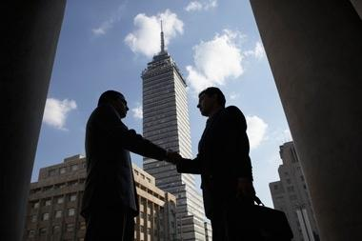


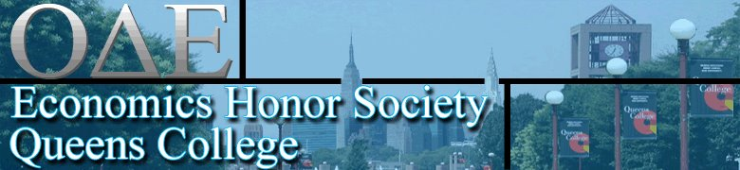
The Private Bank
Wealth Management Workshop
Join Ascend and the Economics Honor Society as we learn
about the exciting career of Wealth Management
from Senior Wealth Advisors at Wells Fargo Private Bank:
Thomas Mackay Belden
Senior Vice President, Wealth Advisor
Gregg Koutouvidis
Senior Vice President, Wealth Advisor
Sponsors:
Date: Monday, November 5, 2012
Time: Free hour (12:15pm-1:30pm)
Location: PH 114
Free Food & Drinks Will Be Served!

